Slide 1
Assignment 6
Marissa Defratti

Slide 2
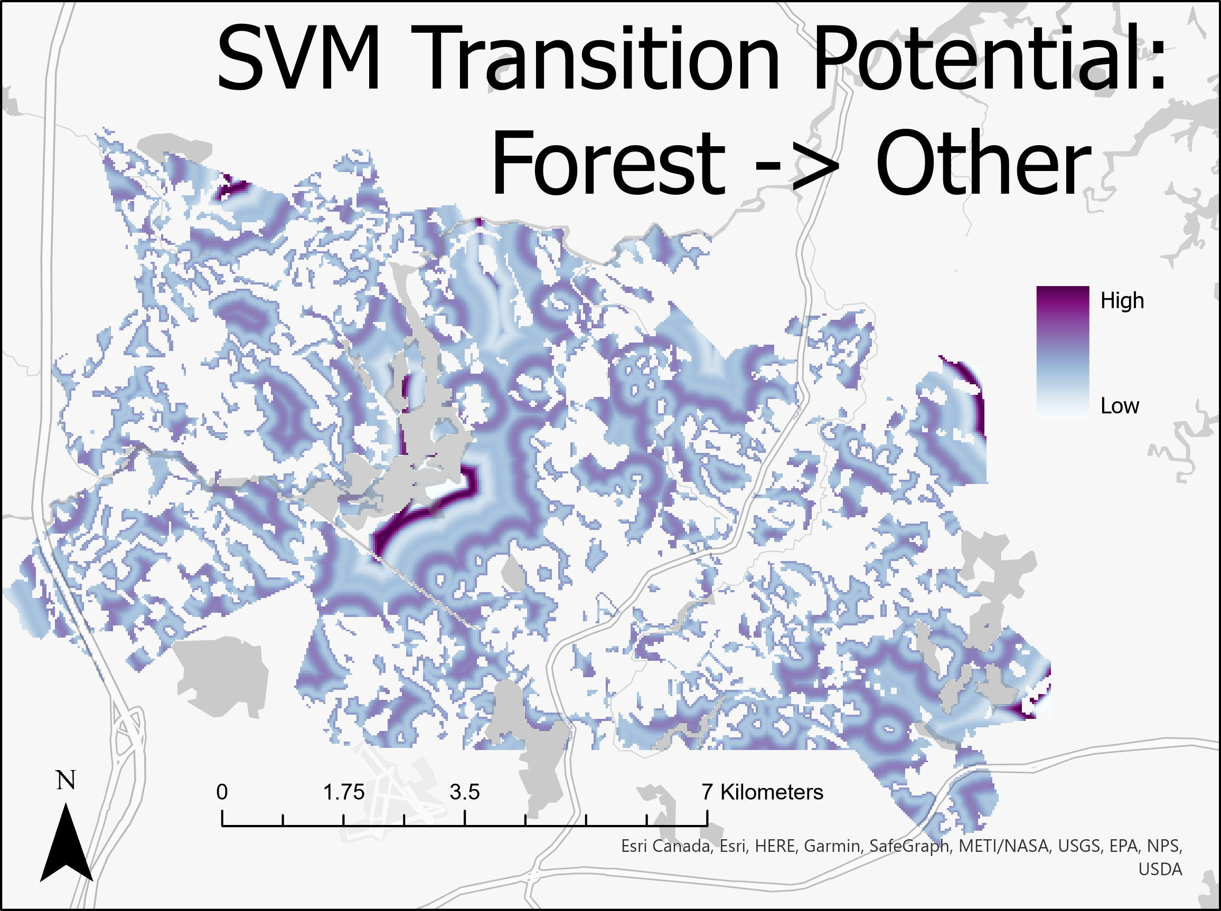
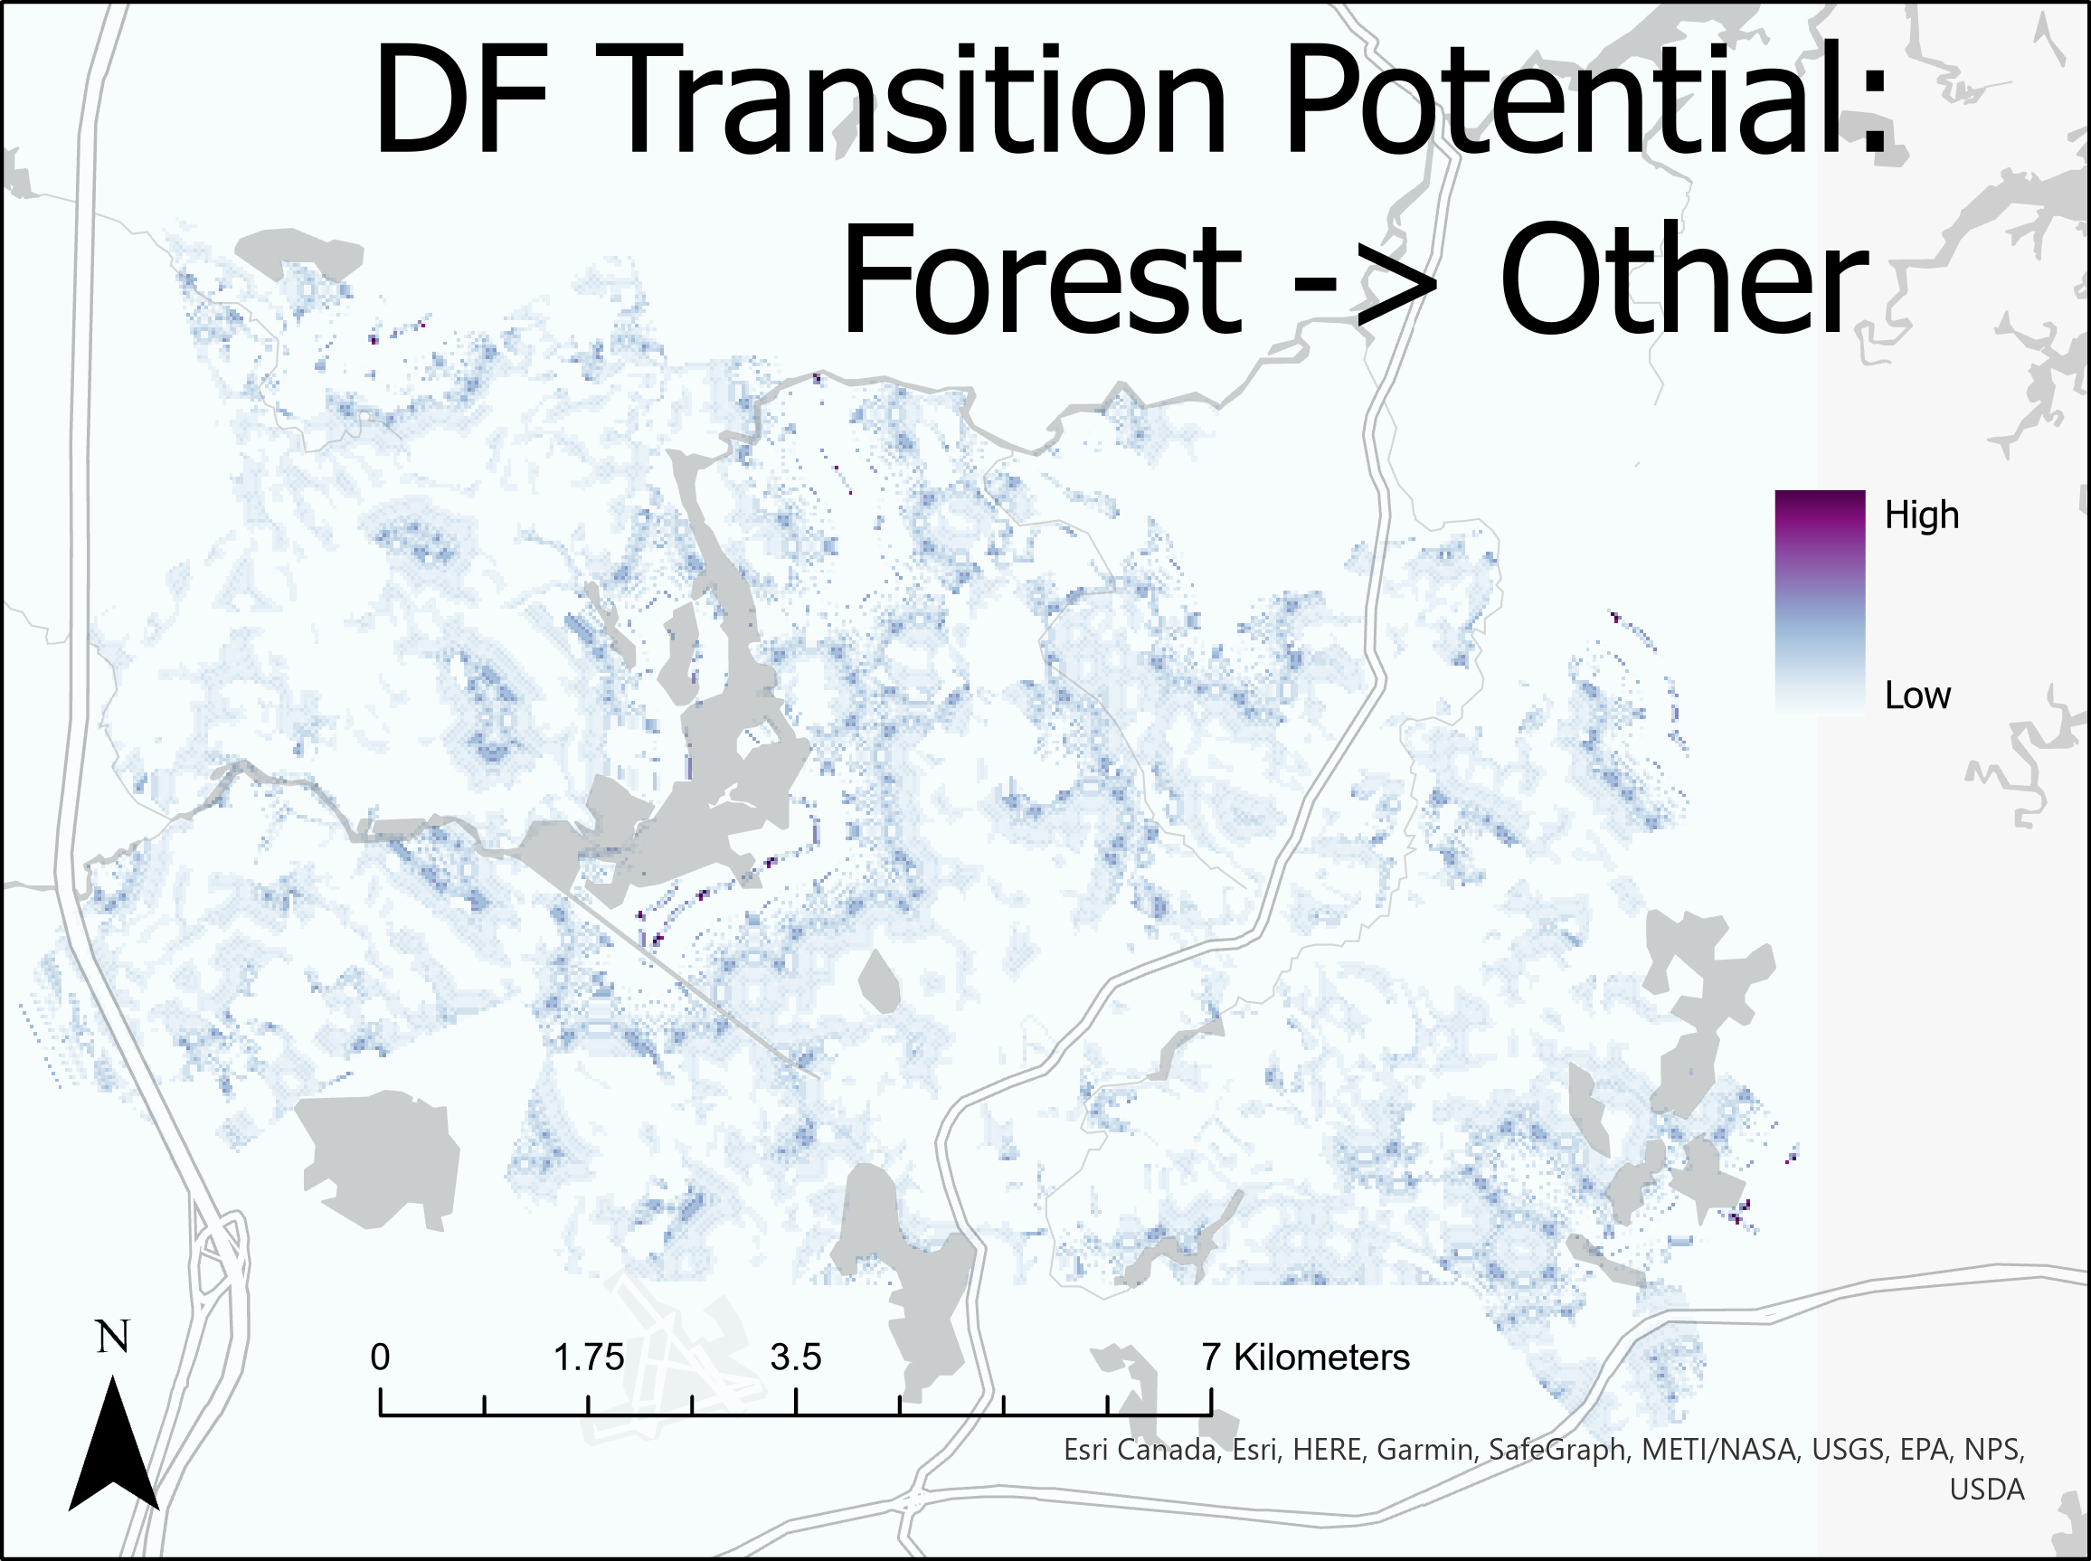
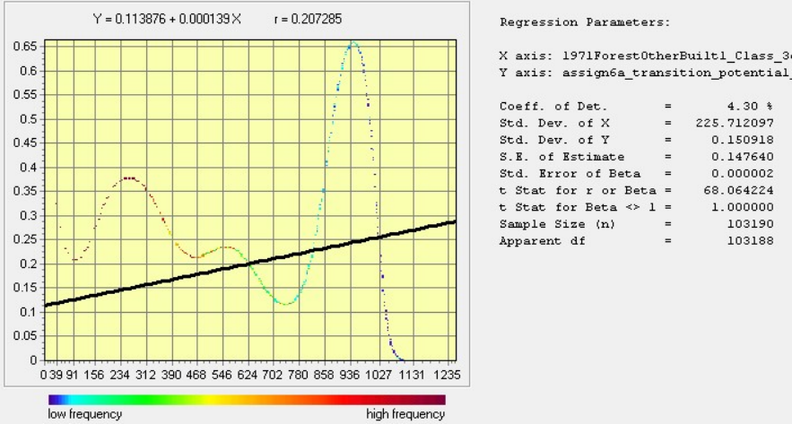
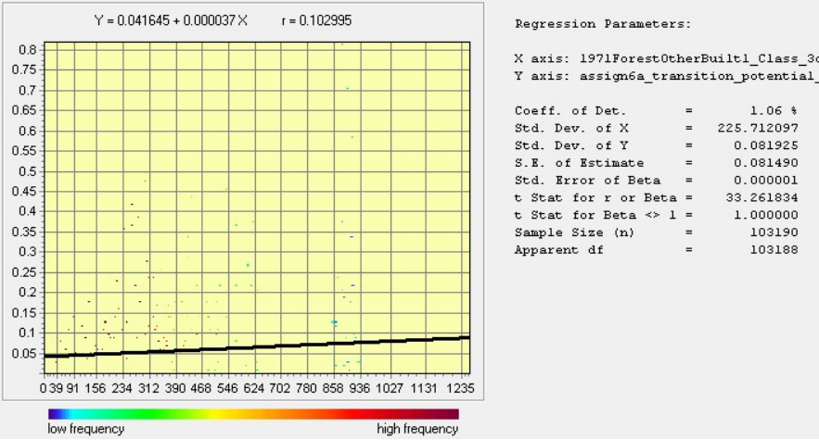
Transition Potential: Forest → Other

Slide 3
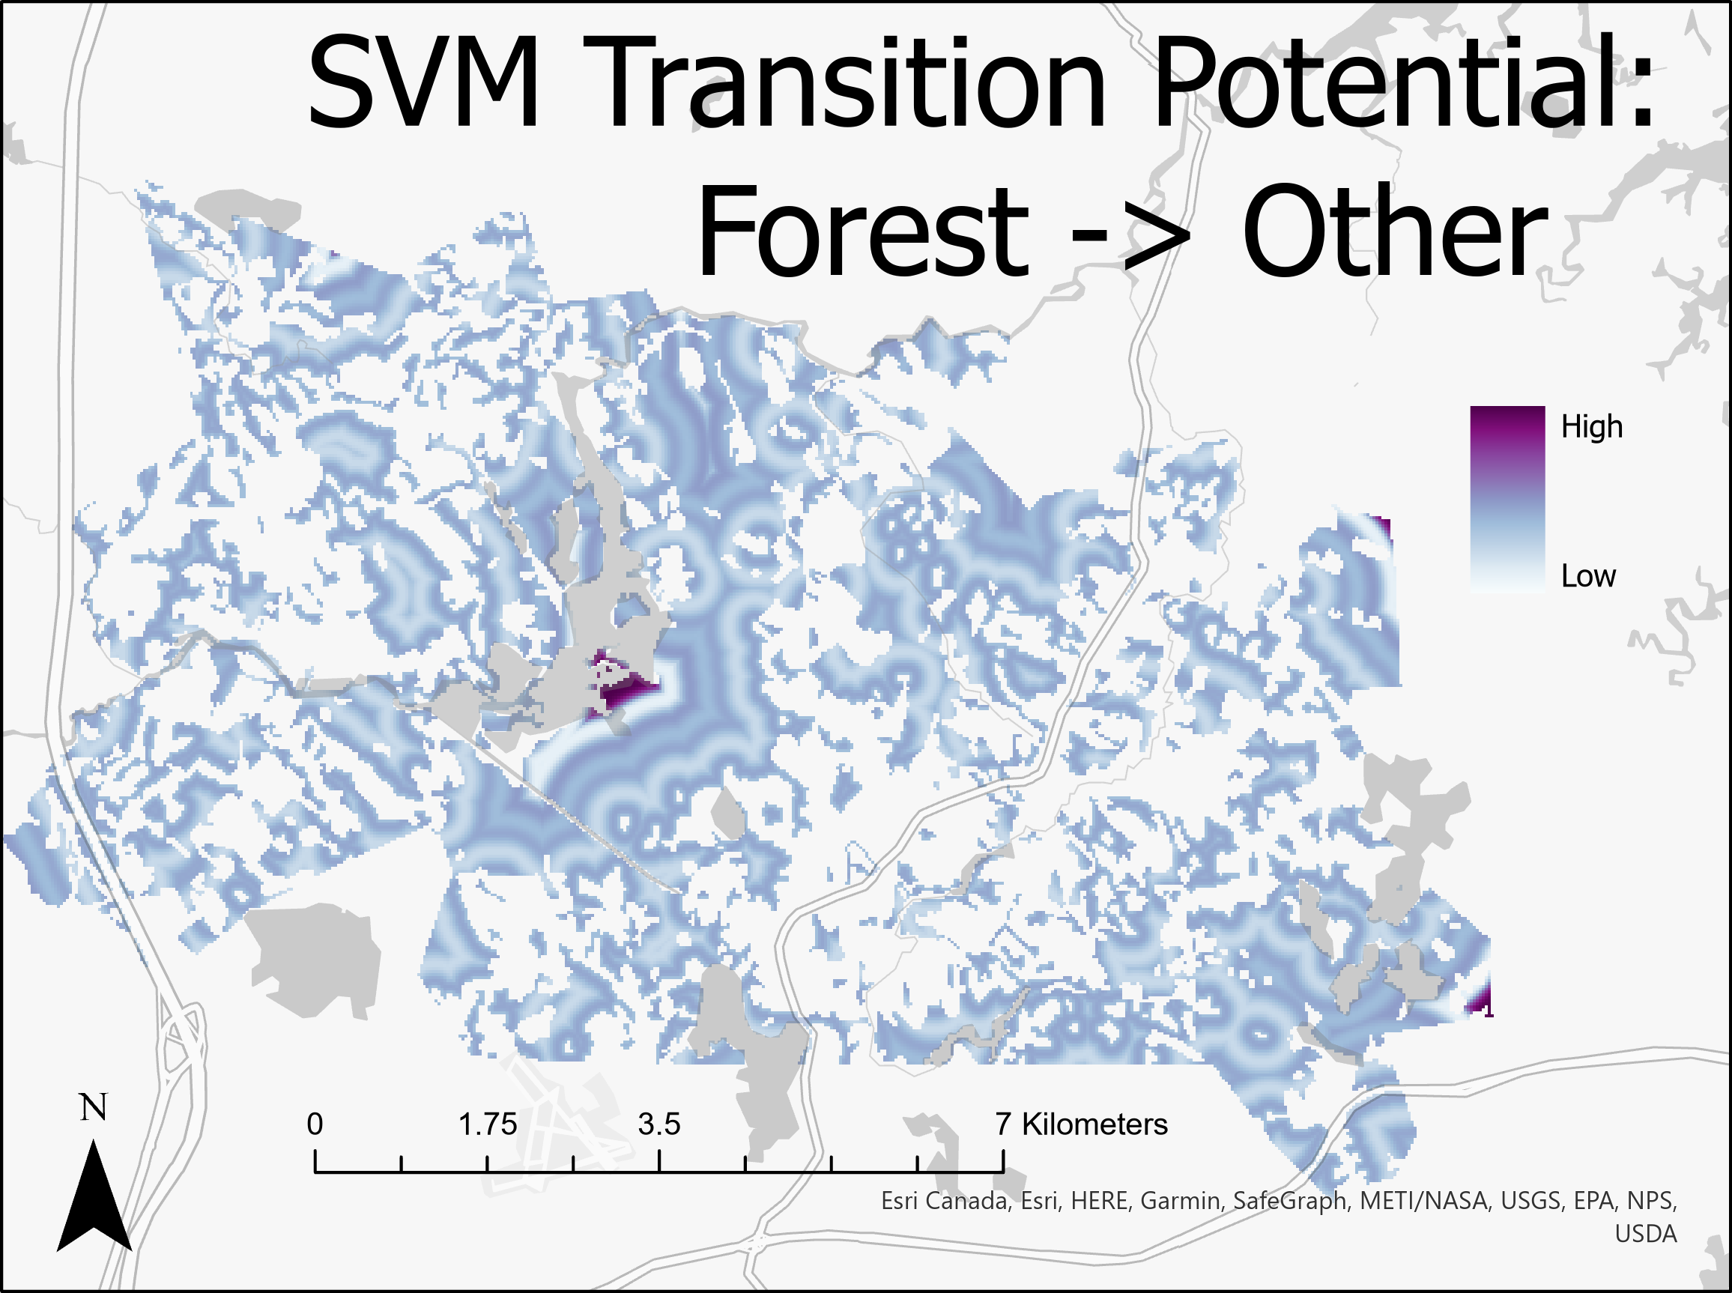
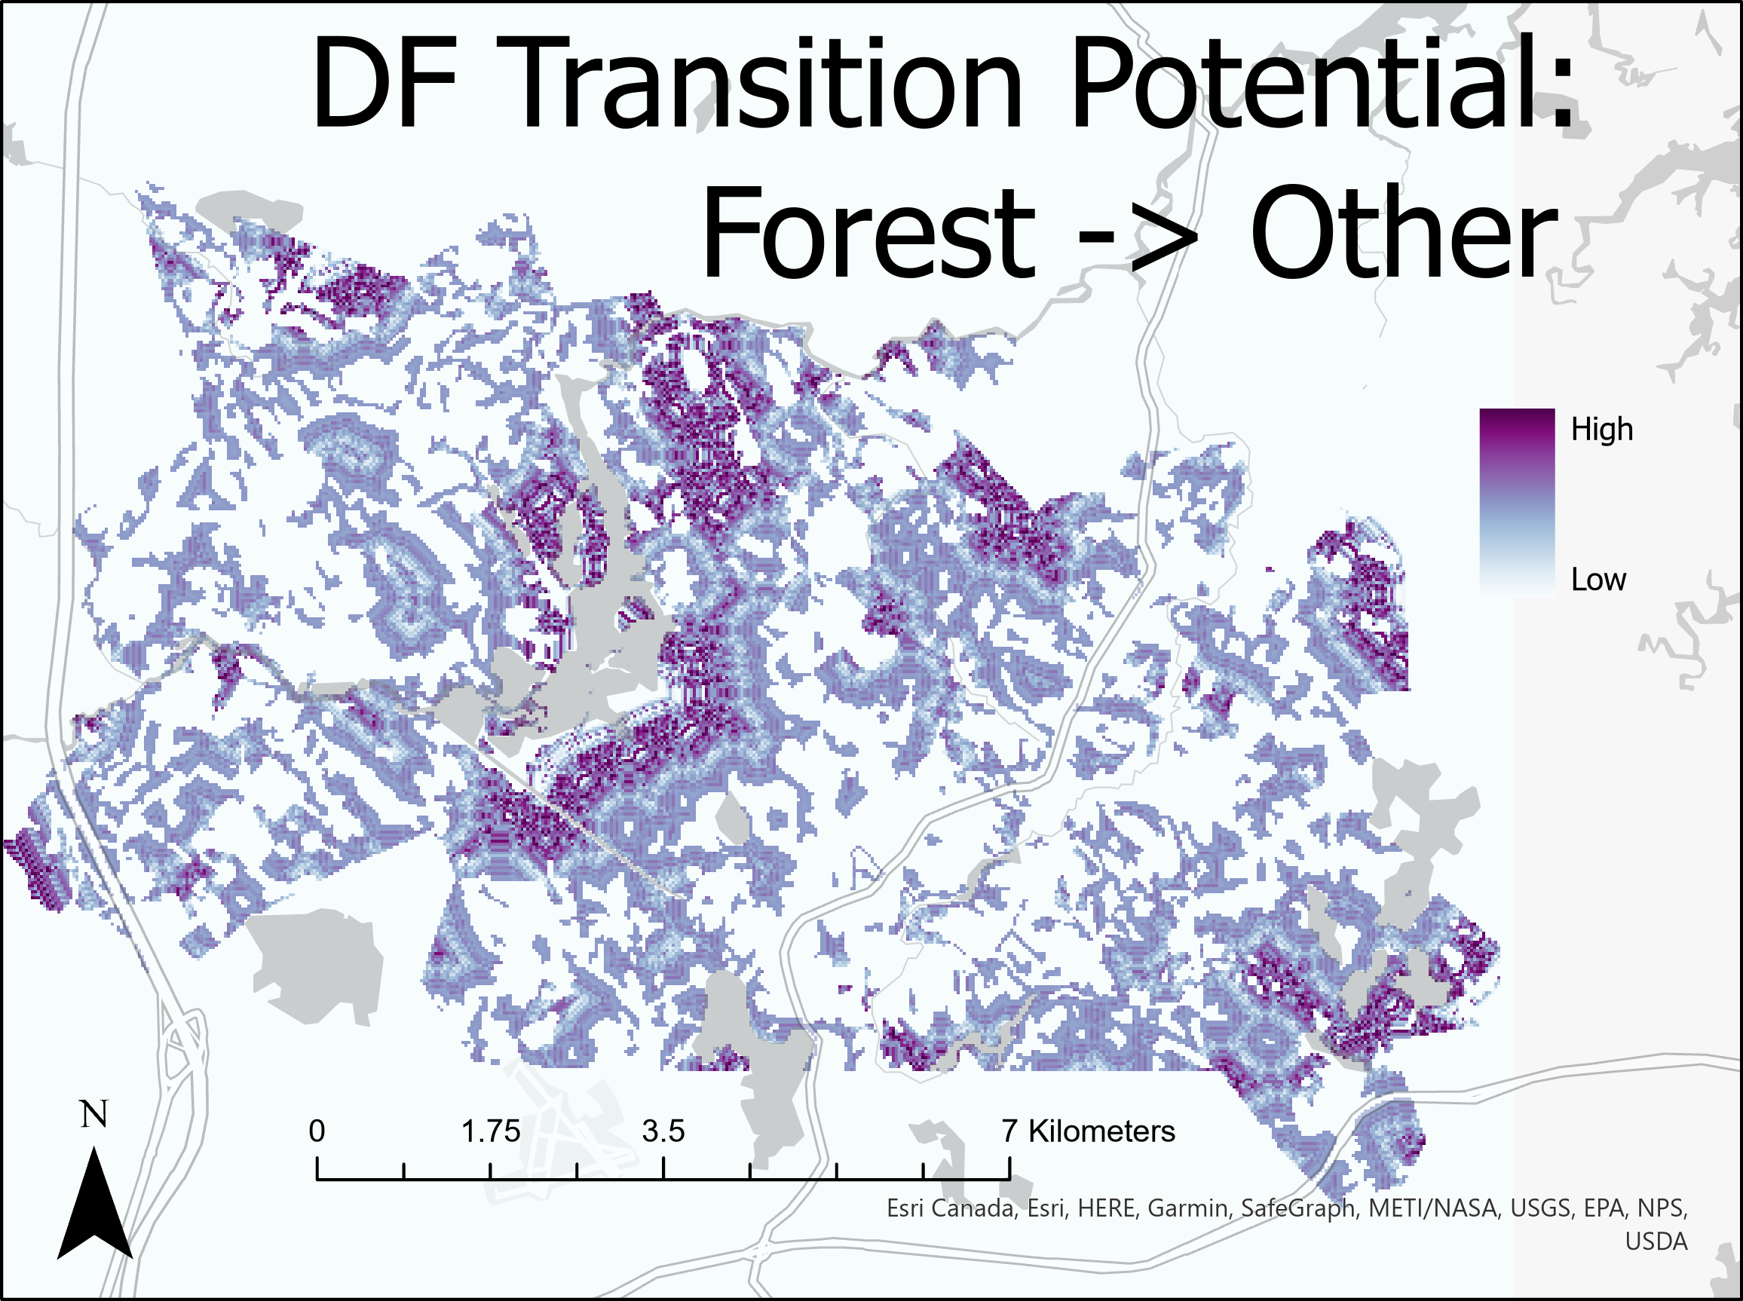
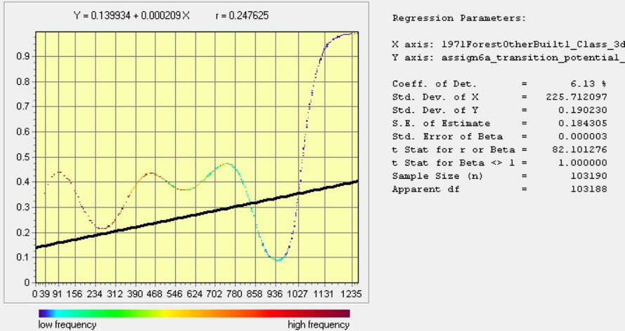
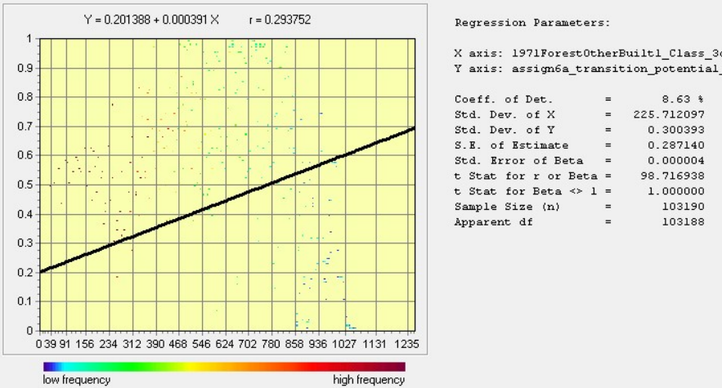
Transition Potential: Forest → Built

Slide 4
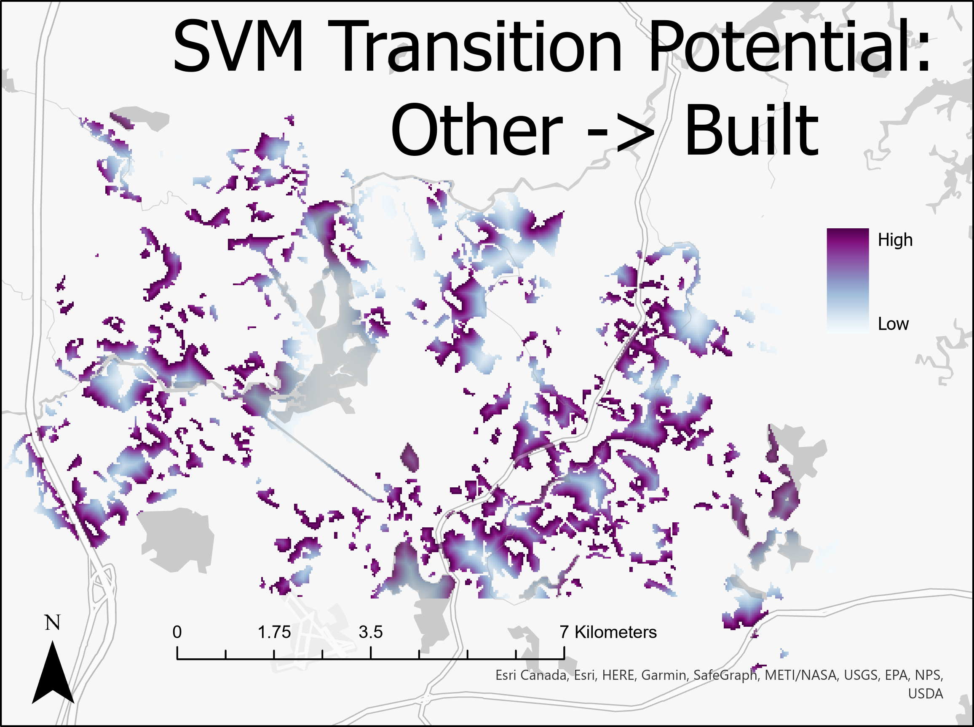
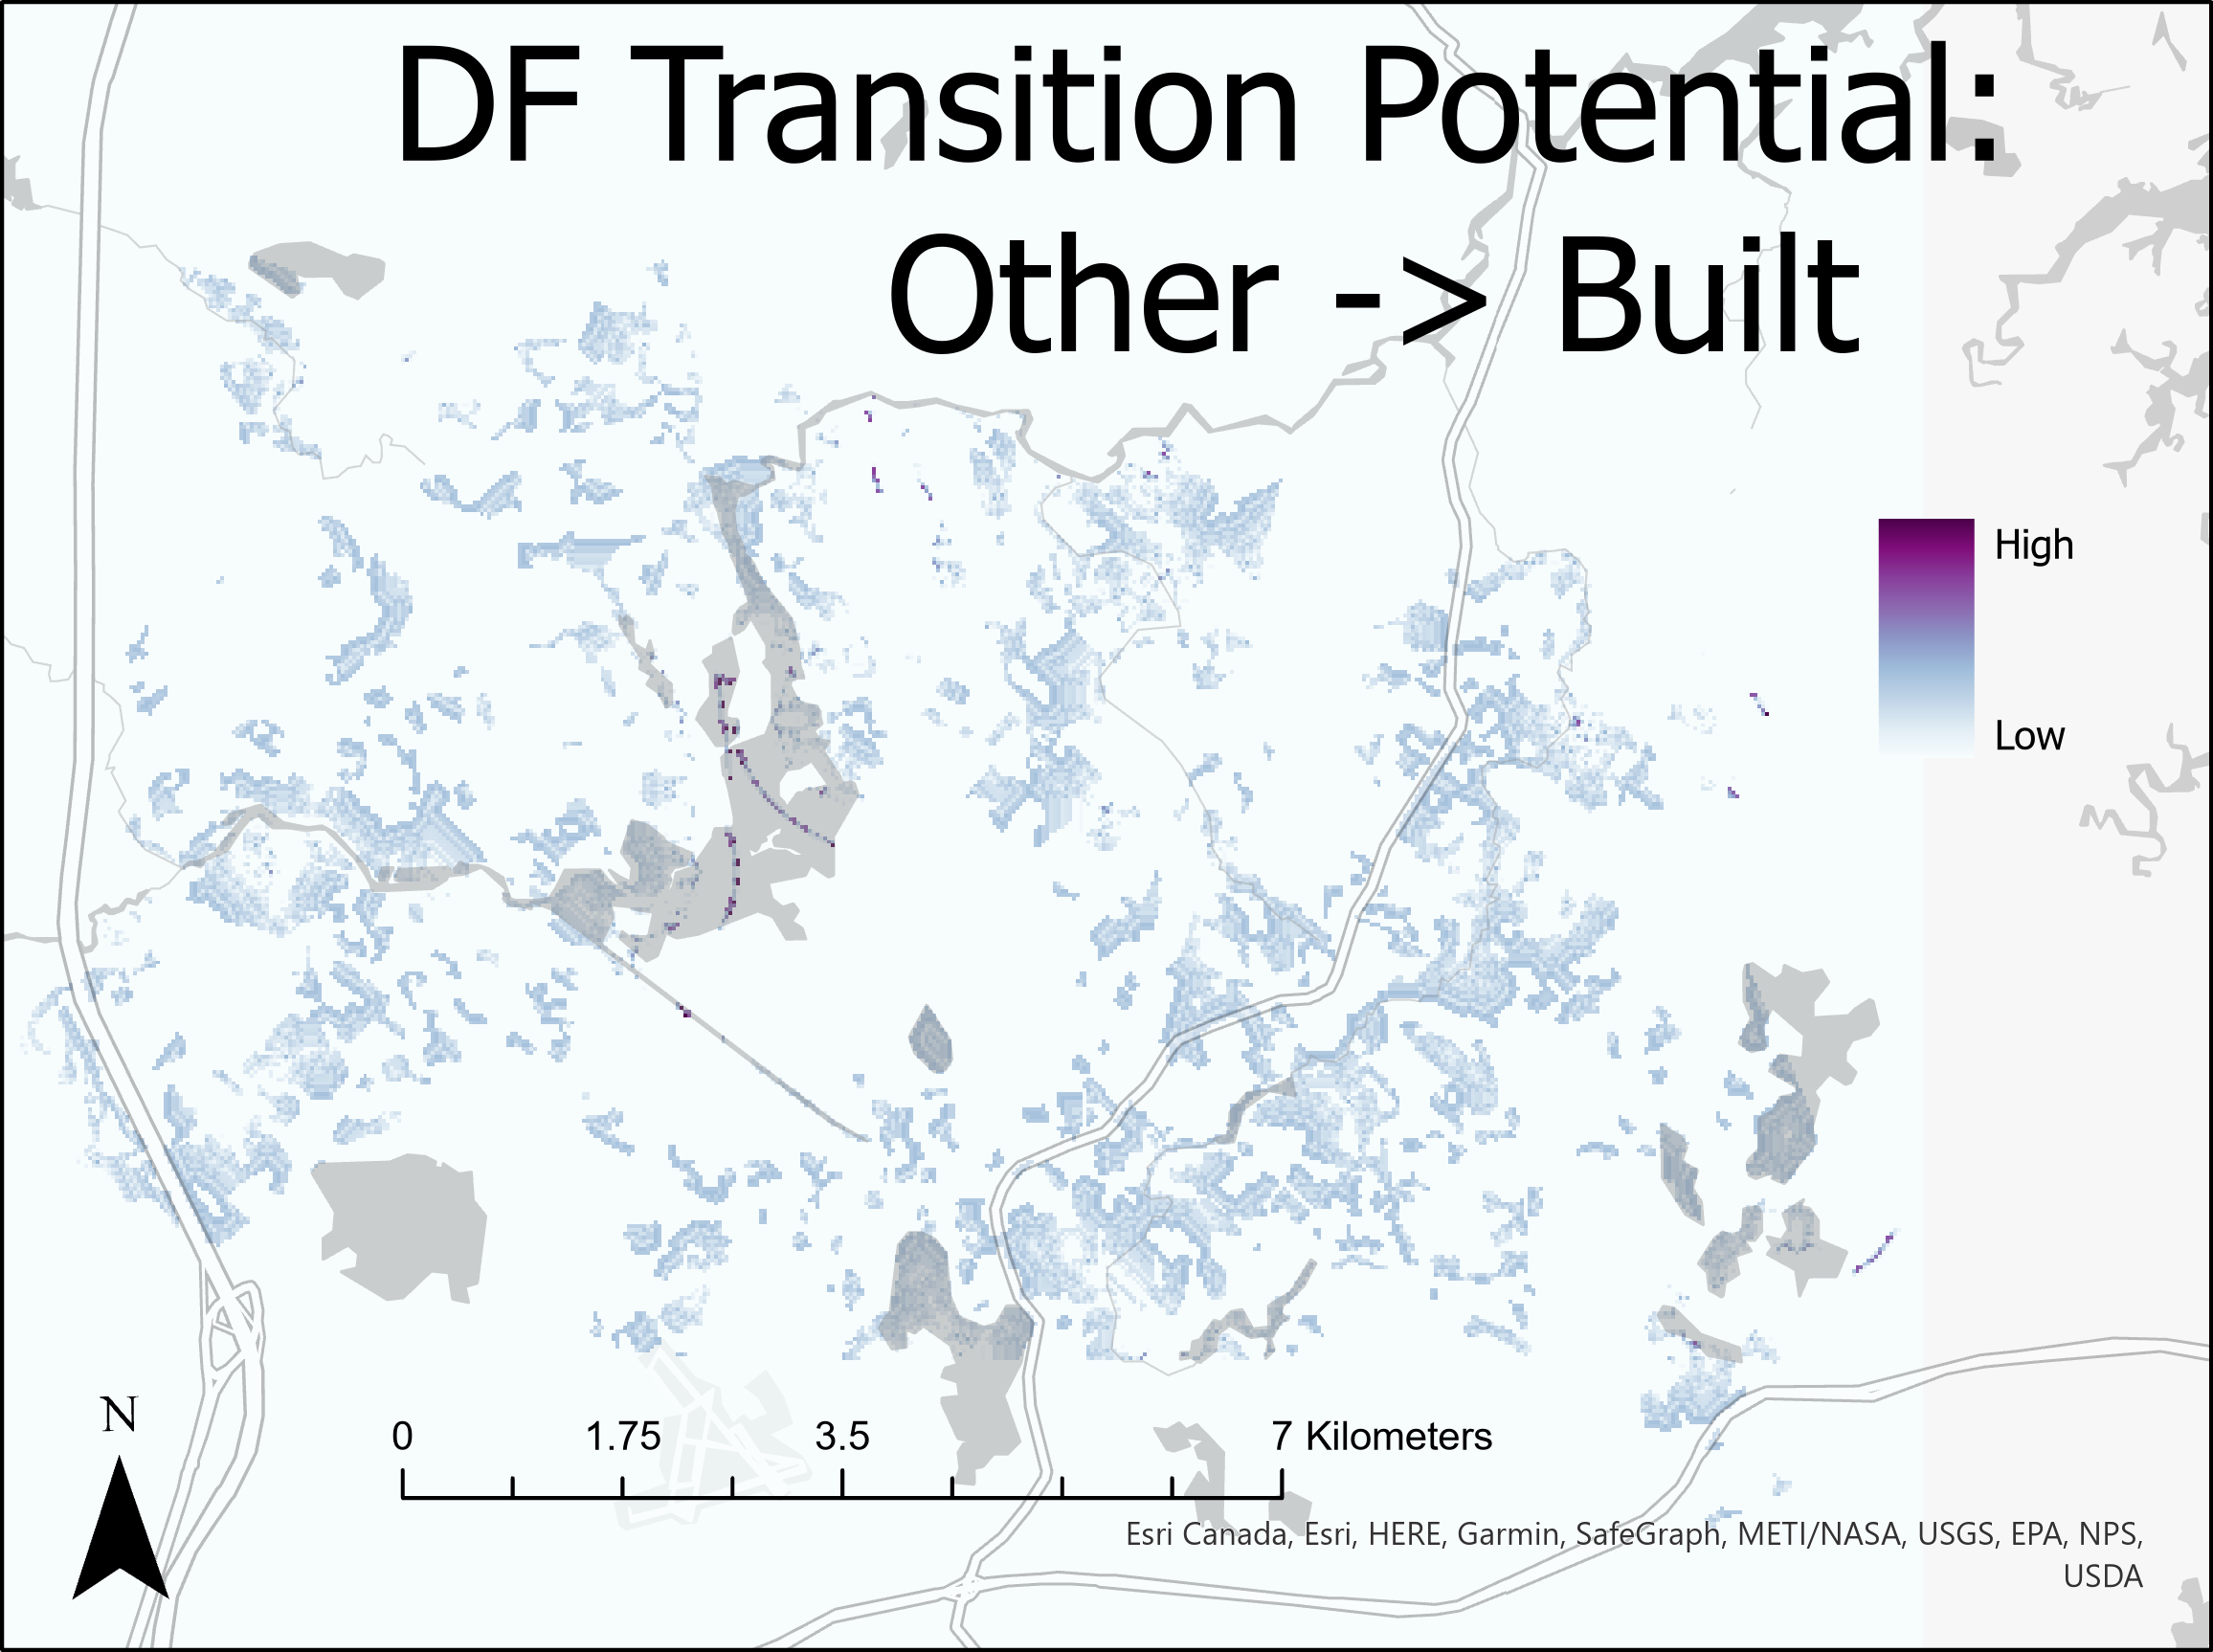
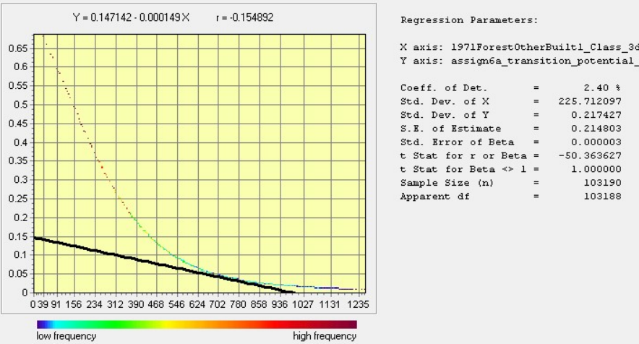
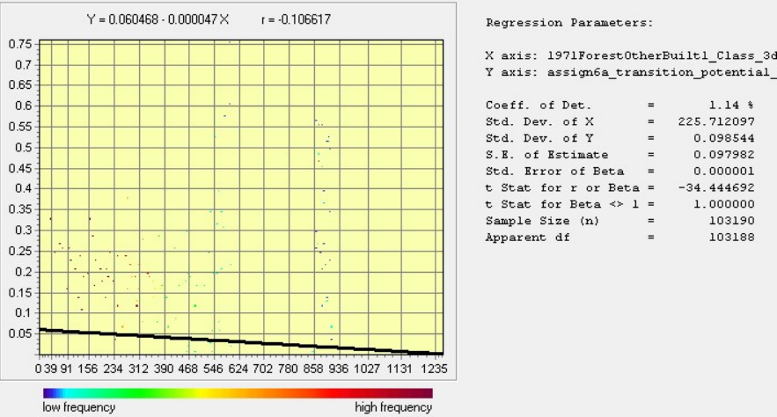
Transition Potential: Other → Built

Slide 5
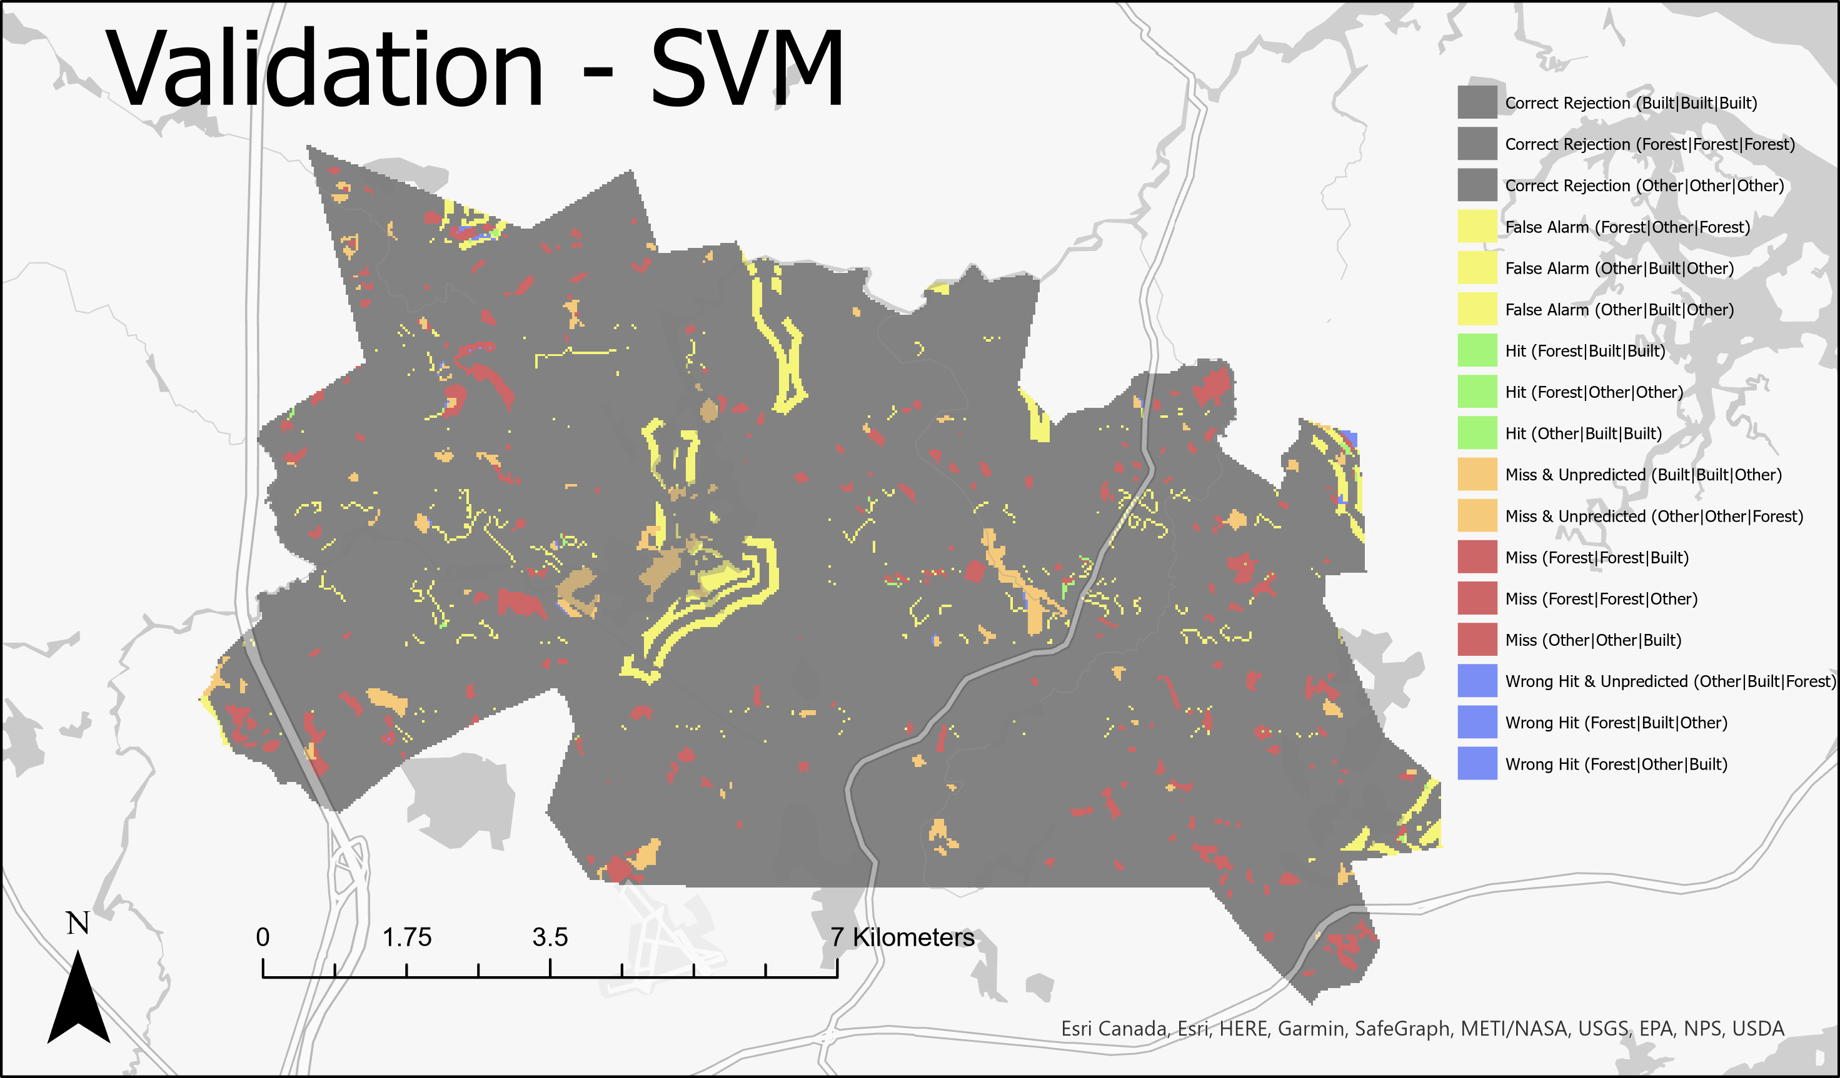
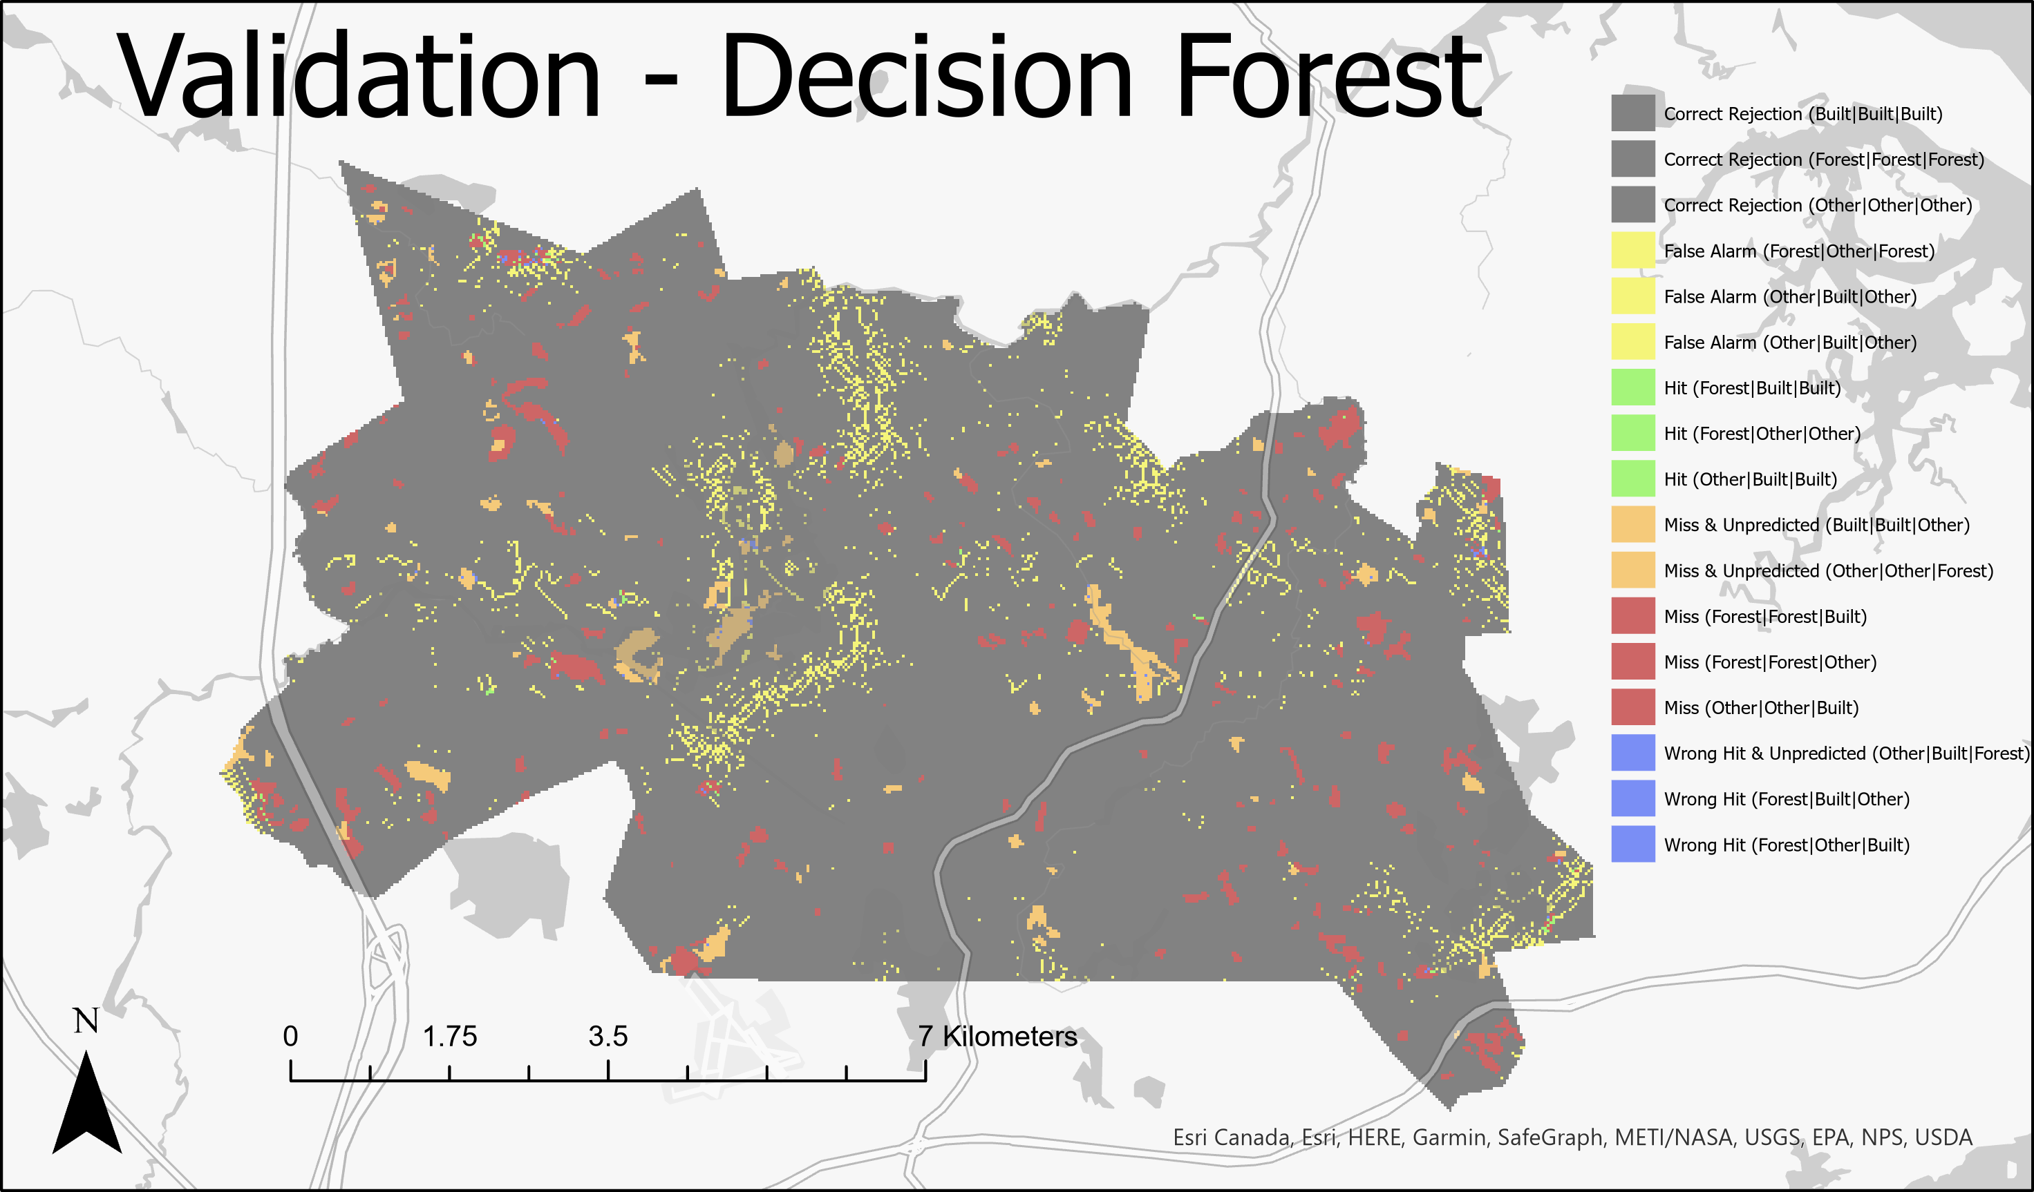
Validation
Correct Rejection | False Alarm | Hit & Built Persistence | Miss & Unpredicted | Miss | Wrong Hit
#Pixels Correct Hits: 56 (0.2%)
#Pixels Total Change: 27540
#Pixels Correct Hits: 74 (0.3%)
#Pixels Total Change: 27577
Notes:
| Why different.. Ref1971-1985) vs. Ref 1985-1999 vs. Sim1985-1999
The reference change between 1971-1985 is the amount of change that occurs during the calibration interval; the reference change that occurs between 1985-1999 is the validation interval; and the simulated change between 1985-1999 depends on how the algorithm measured the transition potential between categories. The calibration interval are the recent trend patterns used to predict, however if the spatial & quantity patterns are different in the validation interval (when compared against the Ref(1985-1999)), then the model has low accuracy.

Slide 6
Algorithm Advice
Q: If colleagues ask you whether they should use SVM or DecisionForest or something else to predict land change, then how would you respond?
I would suggest testing both algorithms by taking 2/3 of the data for calibration and 1/3 of the data for validation then comparing the results both visually between validation maps (CROSSTAB maps), and tabularly (CROSSTAB table). The maps have unique categories in the format of InitialCategory|PredictedCategory|FinalCategory to visualize the accuracy of the prediction when compared against the final reference data. A high number of Hits and Correct Rejections is desirable; Miss/WrongHit & Unpredicted should be investigate to see if change in that area was only present during the validation interval; Misses are unpredicted change; Wrong Hits are the wrong type of predicted change; and False Alarms are wrongly predicted change. Within these categories, they could also look at which types of categorical transitions had the most number of hits, misses, etc. and should choose the model that has the most accurate hits and rejections for their category of interest. The table provides numerical clarity.

